Slide 1





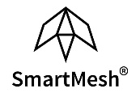

Enterprise Blockchain Developers (Intermediate)
In support of
Powered By

Slide 2
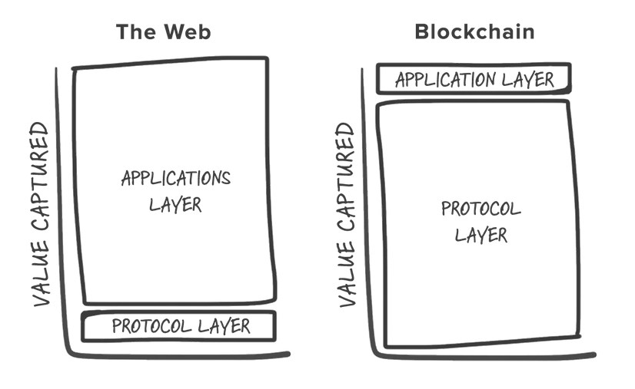
Blockchain Technology History
2016 -2018: most people think public chain is a universal solution

Slide 3
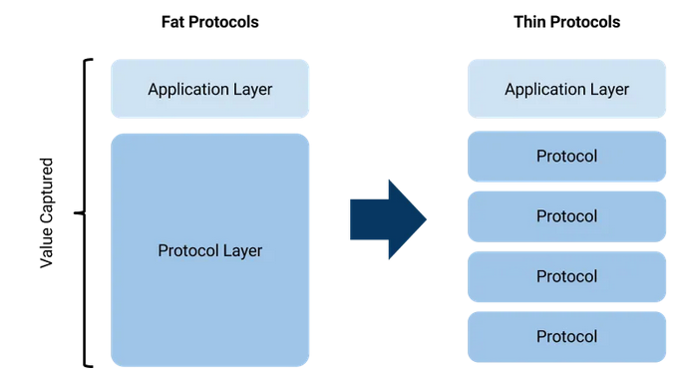
Blockchain Technology History
2019 -2020: Application Specific Chain (Ethereum 14 tps)
Divide the traffic
More centralized (POA, Permissioned Chain)
That makes commercial adption possible

Slide 4
Blockchain Technology Trends
DeFi frameworks are getting mature
Governance is critical
Private (permissioned) blockchains will dominate
Adaption of cross-chain solutions
Sharding

Slide 5
DeFi
Thus far, 2020 hasn’t been the best of years for many. But for decentralised finance, or DeFi, 2020 has been a period of stratospheric growth, with the total value locked in rising from under $1bn, to just under $8bn on Sep. 15, 2020
Why is Defi important? The frameworks are getting mature, after the the real assets being mapped to the chain, lots of new business models will emerge
Type of Defi:
Yield Farming (e.g, Yam, APY Finance)
Insurance (e.g, Nexus Mutual)
Predictions Market (e.g., Augur and others)
Decentralized leverage trading (e.g., dYdX)
Lending Protocols (e.g., Compound, Aave, InstaDApp, and more)
Synthetic assets (e.g., UMA)
Stable Coins

Slide 6
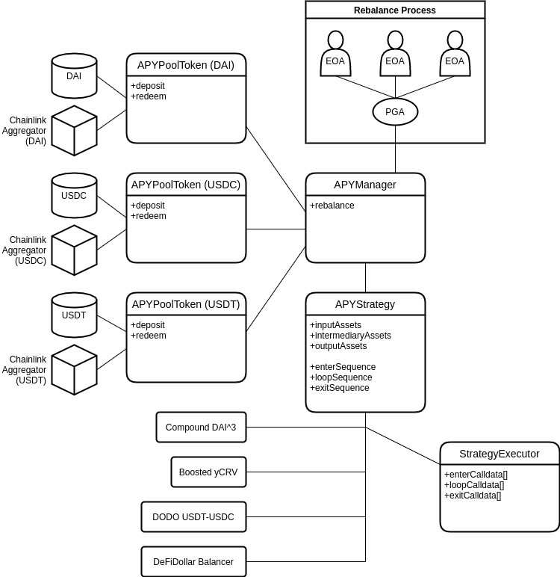
The Mechanism of APY
Stable Coins
deposit
Smart Contract
RedeemReceipt
Obtian Receipt
LP
APT
1. economic of scales, saving gas fee
2. aggregator, one stop shop
Obtian Receipt
Stable Coins
The percentage of yield

Slide 7
The Mechanism of Yam
ETH Pool
X1 yield
MKR Pool
YAM
YAM/ETH
UNIV2/YAM
COMPPool
ETH
staking
staking
X5 yield
UNIV2 Yam
Pool

Slide 8
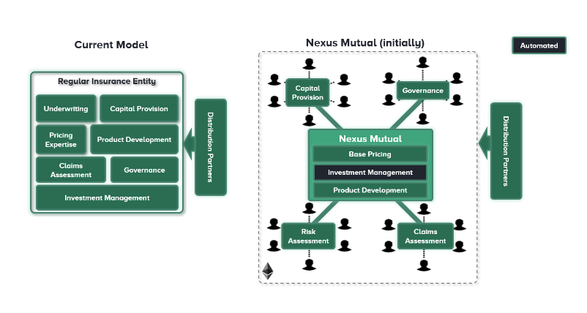
The Mechanism of Nexus Mutual
Deposite
ETH
Capital
Pool
NXM
Insurance Profit

Slide 9
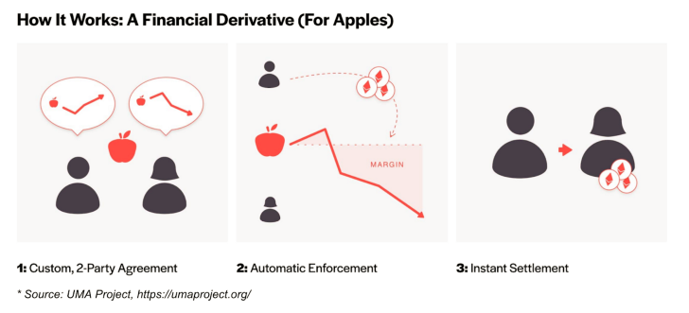
The Mechanism of UMA

Slide 10
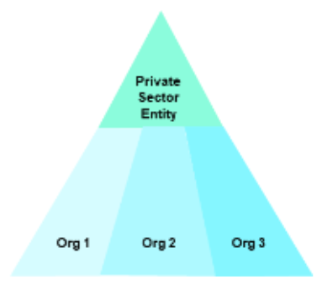
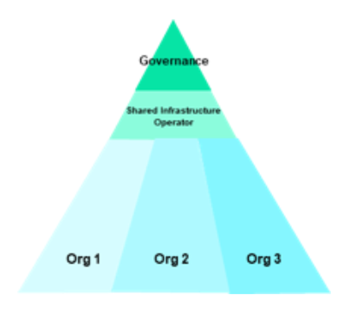
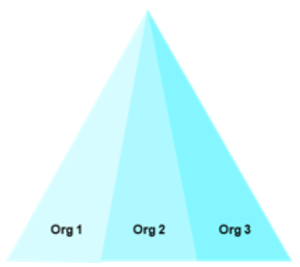
Governance
Trend one: Most of the DeFi projects have community based governance smart contracts to make decisions
Trend two: As the technology matures, we can see that the core challenge in the path of Blockchain’s large-scale adoption is stakeholder management and bringing competitors and unlikely collaborators together to solve shared problems.

Slide 11
Private (permissioned) blockchains
Why?
1 more inter organizational collaboration and more efficient
2 involve more potiential clients to join the community and become the “owner” of a company
markting
client loyalty
Main stream solutions:
Hyperledge Fabric
Ethereum
R3 Corda

Slide 12
Cross-Chain Solutions
Along with the blockchain demand increase, there will be a huge need for the crosschain solutions to connect different isolated chains
Solutions:
1 Messaging Relay
2 Atomic Swap
3 Centralized Gateway

Slide 13
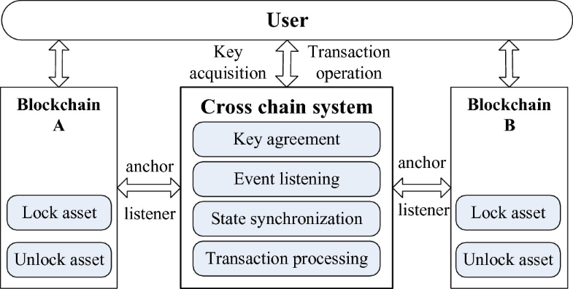
Cross-Chain Solutions

Slide 14
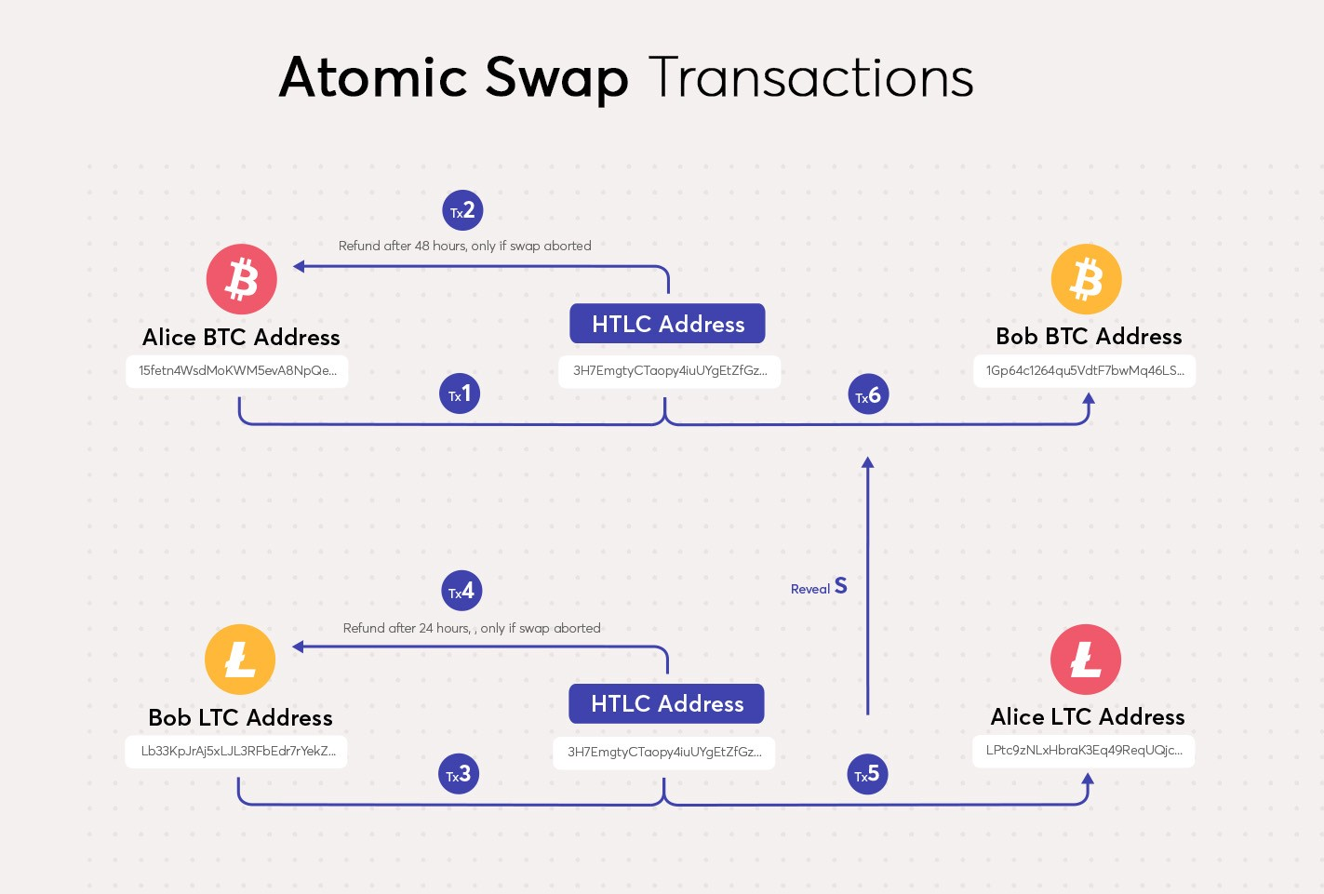
Cross-Chain Solutions

Slide 15
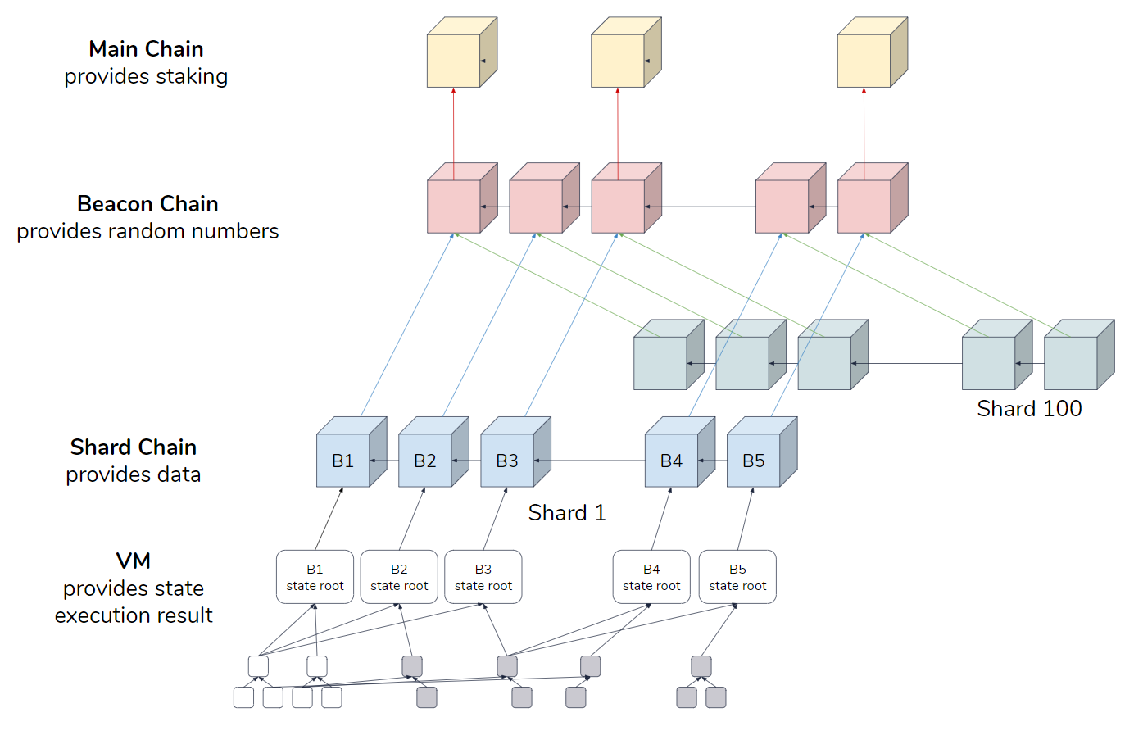
Sharding

